Slide 1
ANYPOINT PLATFORM COMPONENTS BY
CHADA SRIVANI
Under the Guidance of
MR. SURESH

Slide 2
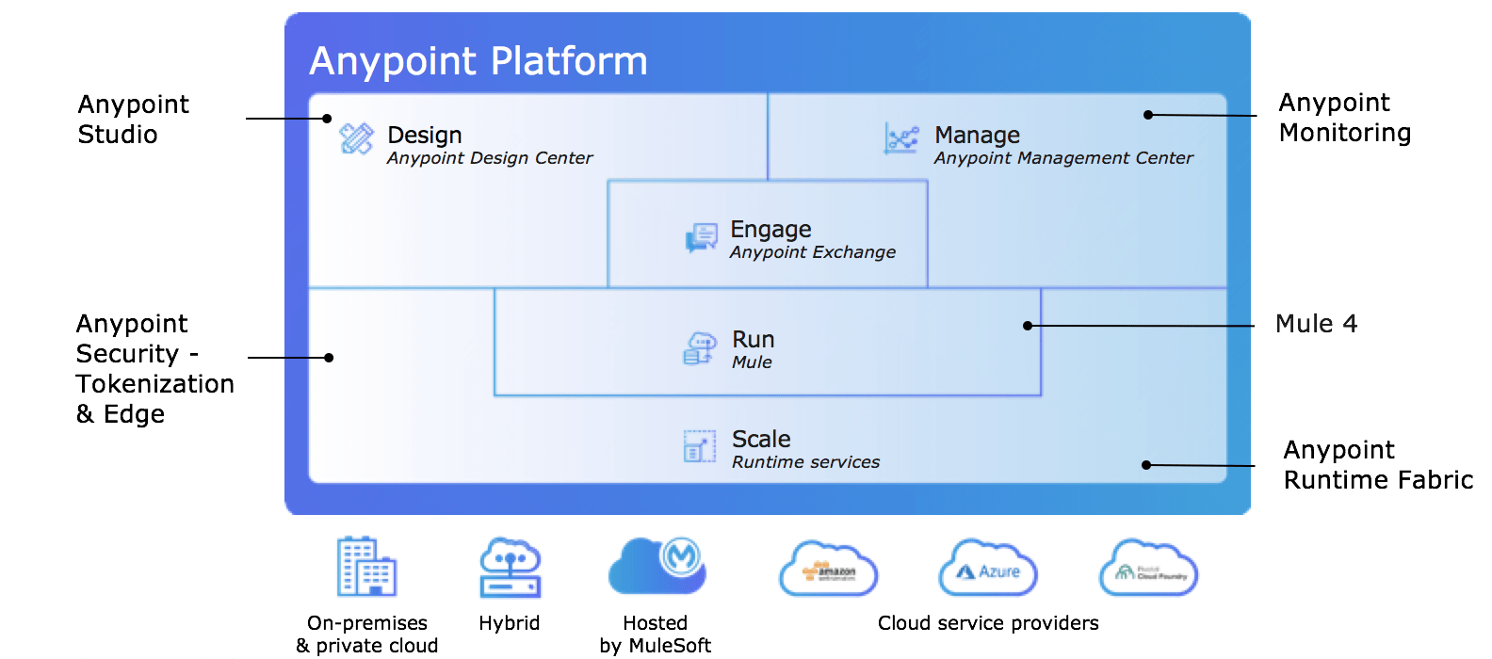
ANYPOINT PLATFORM
Anypoint Platform is a complete solution for API-led connectivity that helps companies build application networks of apps, data, and devices, both on-premises and in the cloud. This hybrid integration platform includes iPaaS, ESB, and a unified solution for API management, design and publishing.

Slide 3
ANYPOINT PLATFORM COMPONENTS
Design center
Management center
Exchange
Run

Slide 4
What is MuleSoft Design Center
.
MuleSoft Design Center or Anypoint Design Center is a development environment that consists of two tools:
API Designer
In API Designer, you can create API specifications in RESTful API Modeling Language (RAML) 0.8 or 1.0, or according to OpenAPI specification (OAS) 2.0 or 3.0. You can also create API fragments in RAML. After you create a specification or fragment, you can publish it to Anypoint Exchange, so that it can be used by anyone in your MuleSoft organization.
Flow Designer
In Flow Designer, you create Mule applications to integrate systems into workflows.

Slide 5
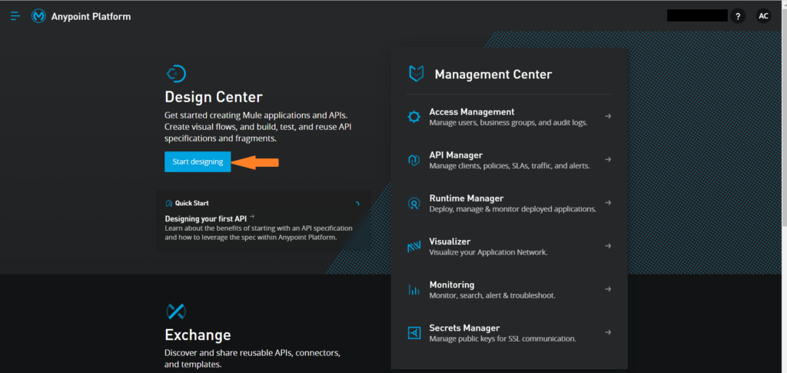

Slide 6
MANAGEMENT CENTER
API management center is the process of designing, publishing, documenting and analyzing APIs in a secure environment. ... API store - API management solutions provide users with the ability to keep their APIs in a store or catalog where they can expose them to internal and/or external stakeholders.
Benefits of API management center:
Create a flexible and dynamic ecosystem
Increase agility by rapidly creating new digital assets
Leverage the value of your existing legacy systems
Make data-driven decisions through business insights
Create a seamless user experience for your customers

Slide 7
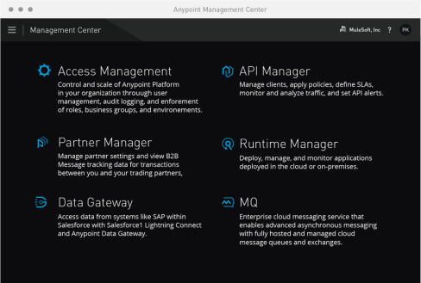

Slide 8
EXCHANGE
Anypoint Exchange provides the benefit of being able to discover, share, and incorporate assets and resources into your applications. Anypoint Exchange helps you create API developer portals, view and test APIs, simulate data to APIs (Mocking Service), create assets, and use API Notebooks to describe and test API functions

Slide 9
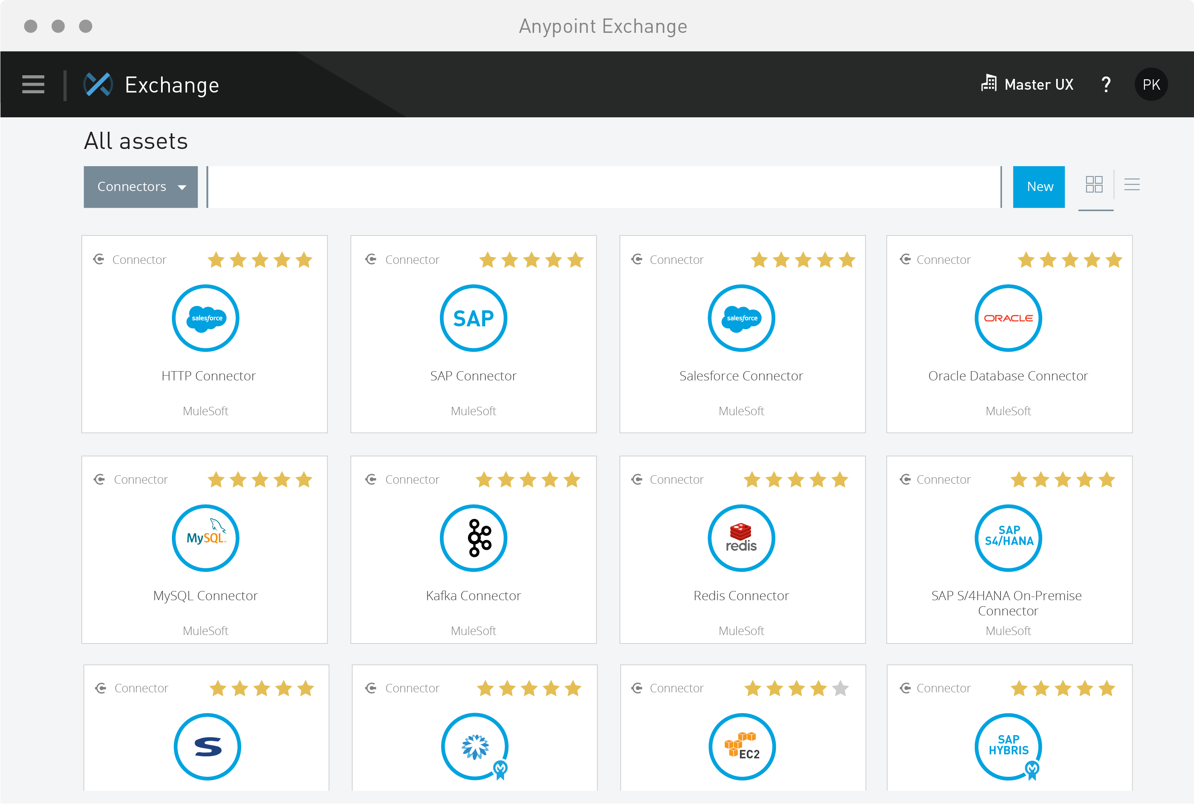

Slide 10
ANYPOINT STUDIO
This is an integrated development enviroment it Is helpful to create your mule applications helpful to design your application develop our Apis and the package the into jar it has inbuilt mule runtime as well so that you can test apart from that any Anypoint platform

Slide 11
